Slide 1
Our new flood warning service in your area
Golden Brook and Stream
Breaston
Notes:
Equipment:
Laptop - Tick
Projector
Table
Tablecloth
Projector screen
Handouts - Tick

Slide 2

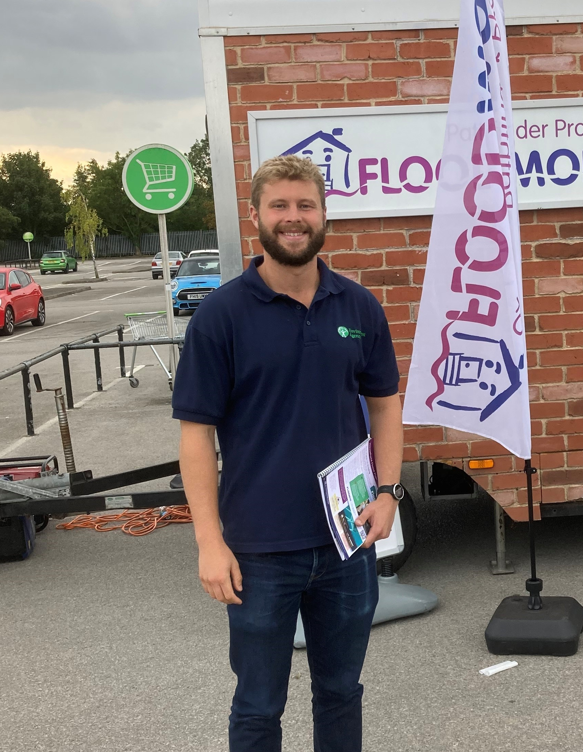
Introductions
Chris Jones
Flood Resilience Engagement Advisor
Dan Matthews
Flood Resilience Officer

Slide 3
What we’ll cover this evening
Overview of Flood Warning Service
Breaston’s New Flood Warning Service
Improving your Flood Warning
Flood Warden Scheme
Property Flood Protection

Slide 4



We issue 3 levels of flood warning
Flood Alert – Prepare. Flooding is possible
Flood Warning – Act. Flooding to property is expected. Immediate action required
Severe Flood Warning – Survive. Severe flooding. Danger to life

Slide 5
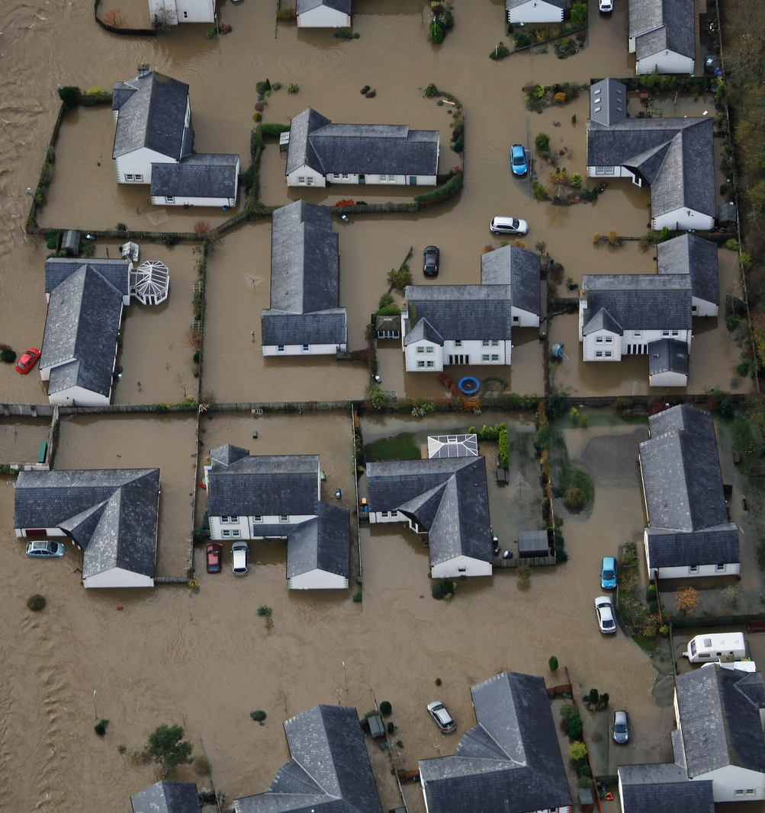
Your new flood warning service
We are pleased to be able to offer a new flood warning service in your area
Flood warnings give people valuable time to prepare for flooding – time that allows you to move yourselves, your families and precious items to safety
Flood warnings save lives and enable the emergency services to prepare and help communities

Slide 6
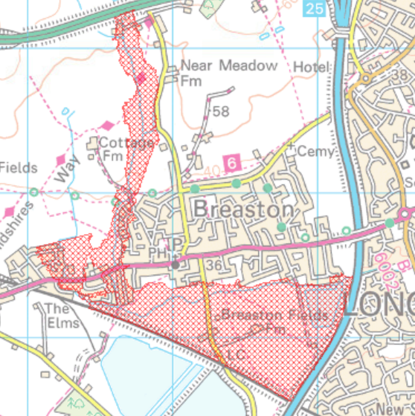
Your new flood warning service
Map showing flood warning area based on maximum predicted flood extent
Flood Warning thresholds are based on the first properties to flood
We welcome feedback on the performance of your new flood warnings

Slide 7
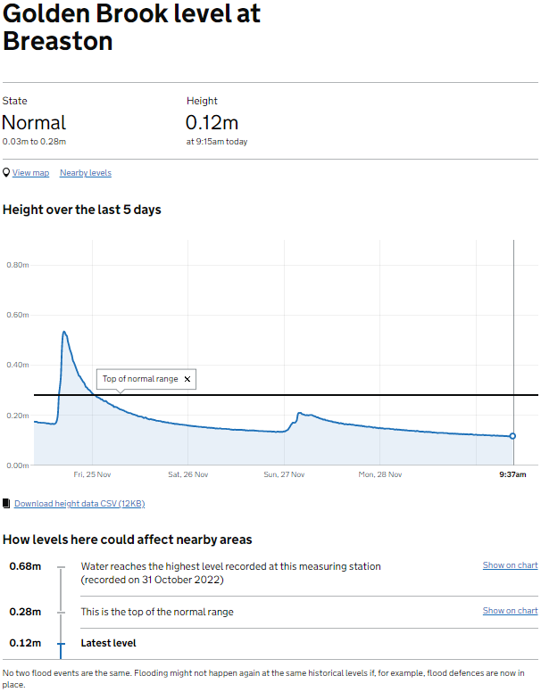
Monitoring your new gauge
Search ‘check river levels online’ and then enter ‘Breaston’ in search box to view gauge levels
Levels will update twice daily or every 15 minutes in high flows
Hydrograph shows the river level in relation to time
Flood alert issued at 1.85m
Flood warning issued at 2m

Slide 8
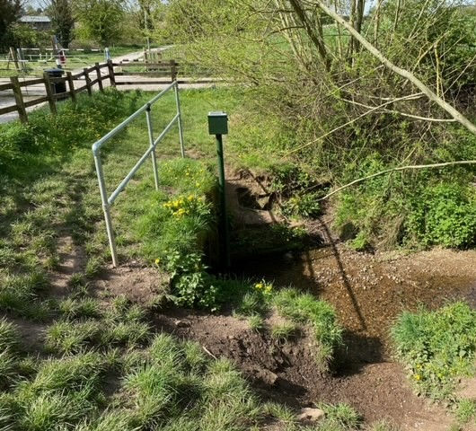
How customers receive our flood warnings
You can receive warnings by:
Text message
Automated phone call
Email

Slide 9
Your warning service; what to expect
Accuracy of flood warnings improves over time
In the short term, there may be a higher-than-normal occurrence of false alarms.
On small watercourses, flooding can happen quickly after heavy rain.

Slide 10
Register to our service
Fully register now at gov.uk/sign-up-for-flood-warnings or call floodline on 0845 988 1188 to make the most of the service:
Flood alerts, which indicate that flooding to low lying land and roads is possible
Flood warnings, issued when property flooding is expected
Receive warnings by text message, voice message, or email

Slide 11


Help us to improve our service
Staff are deployed to flooded areas to validate flood extents and improve the accuracy of warnings
We would like your help to improve the service, please report any false warning alarms to Breaston Parish Council
Report any flooding to:
Floodline 0345 988 11 88
Incident Communication Service 0800 80 70 60

Slide 12
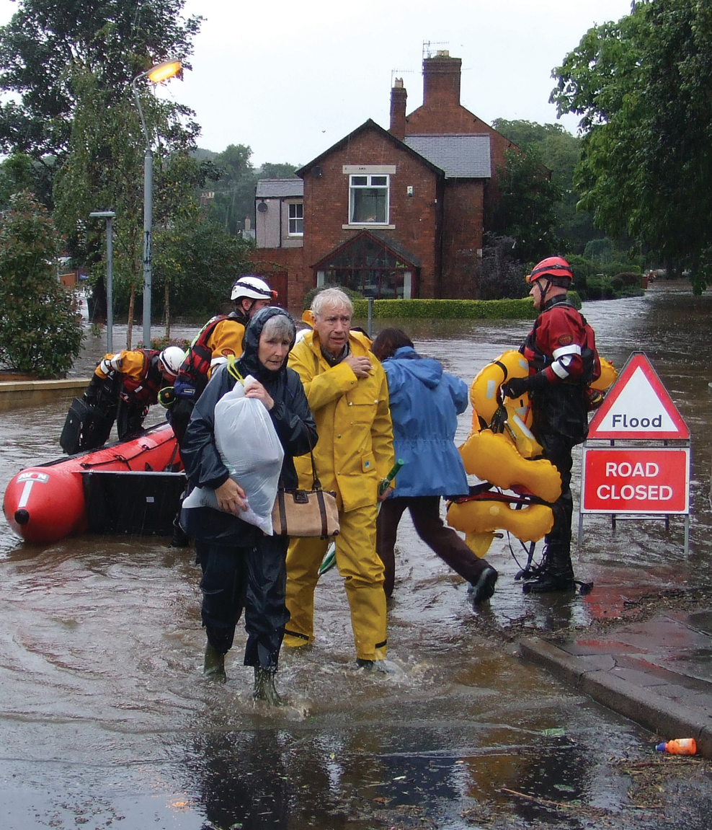
Work as a community to be better prepared for flooding
Working together as a team with neighbours, or local community groups will help you respond quickly and reduce stress and damage when flooding happens and helps to
share local flood knowledge and concerns
identify useful equipment and resources that can be shared before, during and after a flood
protect vulnerable people
enable you and the community to recover quickly

Slide 13
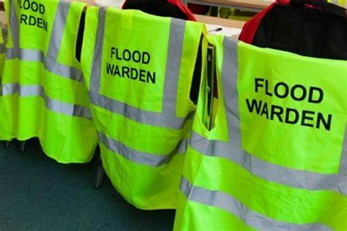
Becoming a flood warden
Flood Wardens are people like you who want to help their community to understand their flood risk and prepare for the impacts of flooding
Support and training will be provided, along with assistance with the production of a Community Flood Plan.

Slide 14
Flood warden role
Work together with public services to promote community led flood resilience. This could be in a variety of ways which include:
• Ensuring members of the community are signed up to receive flood warnings and understand what they mean
• Keeping Environment Agency flood duty officers informed during an incident
• Working as a community to prepare for a flood event and identify vulnerable people within the community who may need extra help
• Reporting blocked drains, ditches, etc to the relevant authority
• Developing a Community Flood Plan

Slide 15
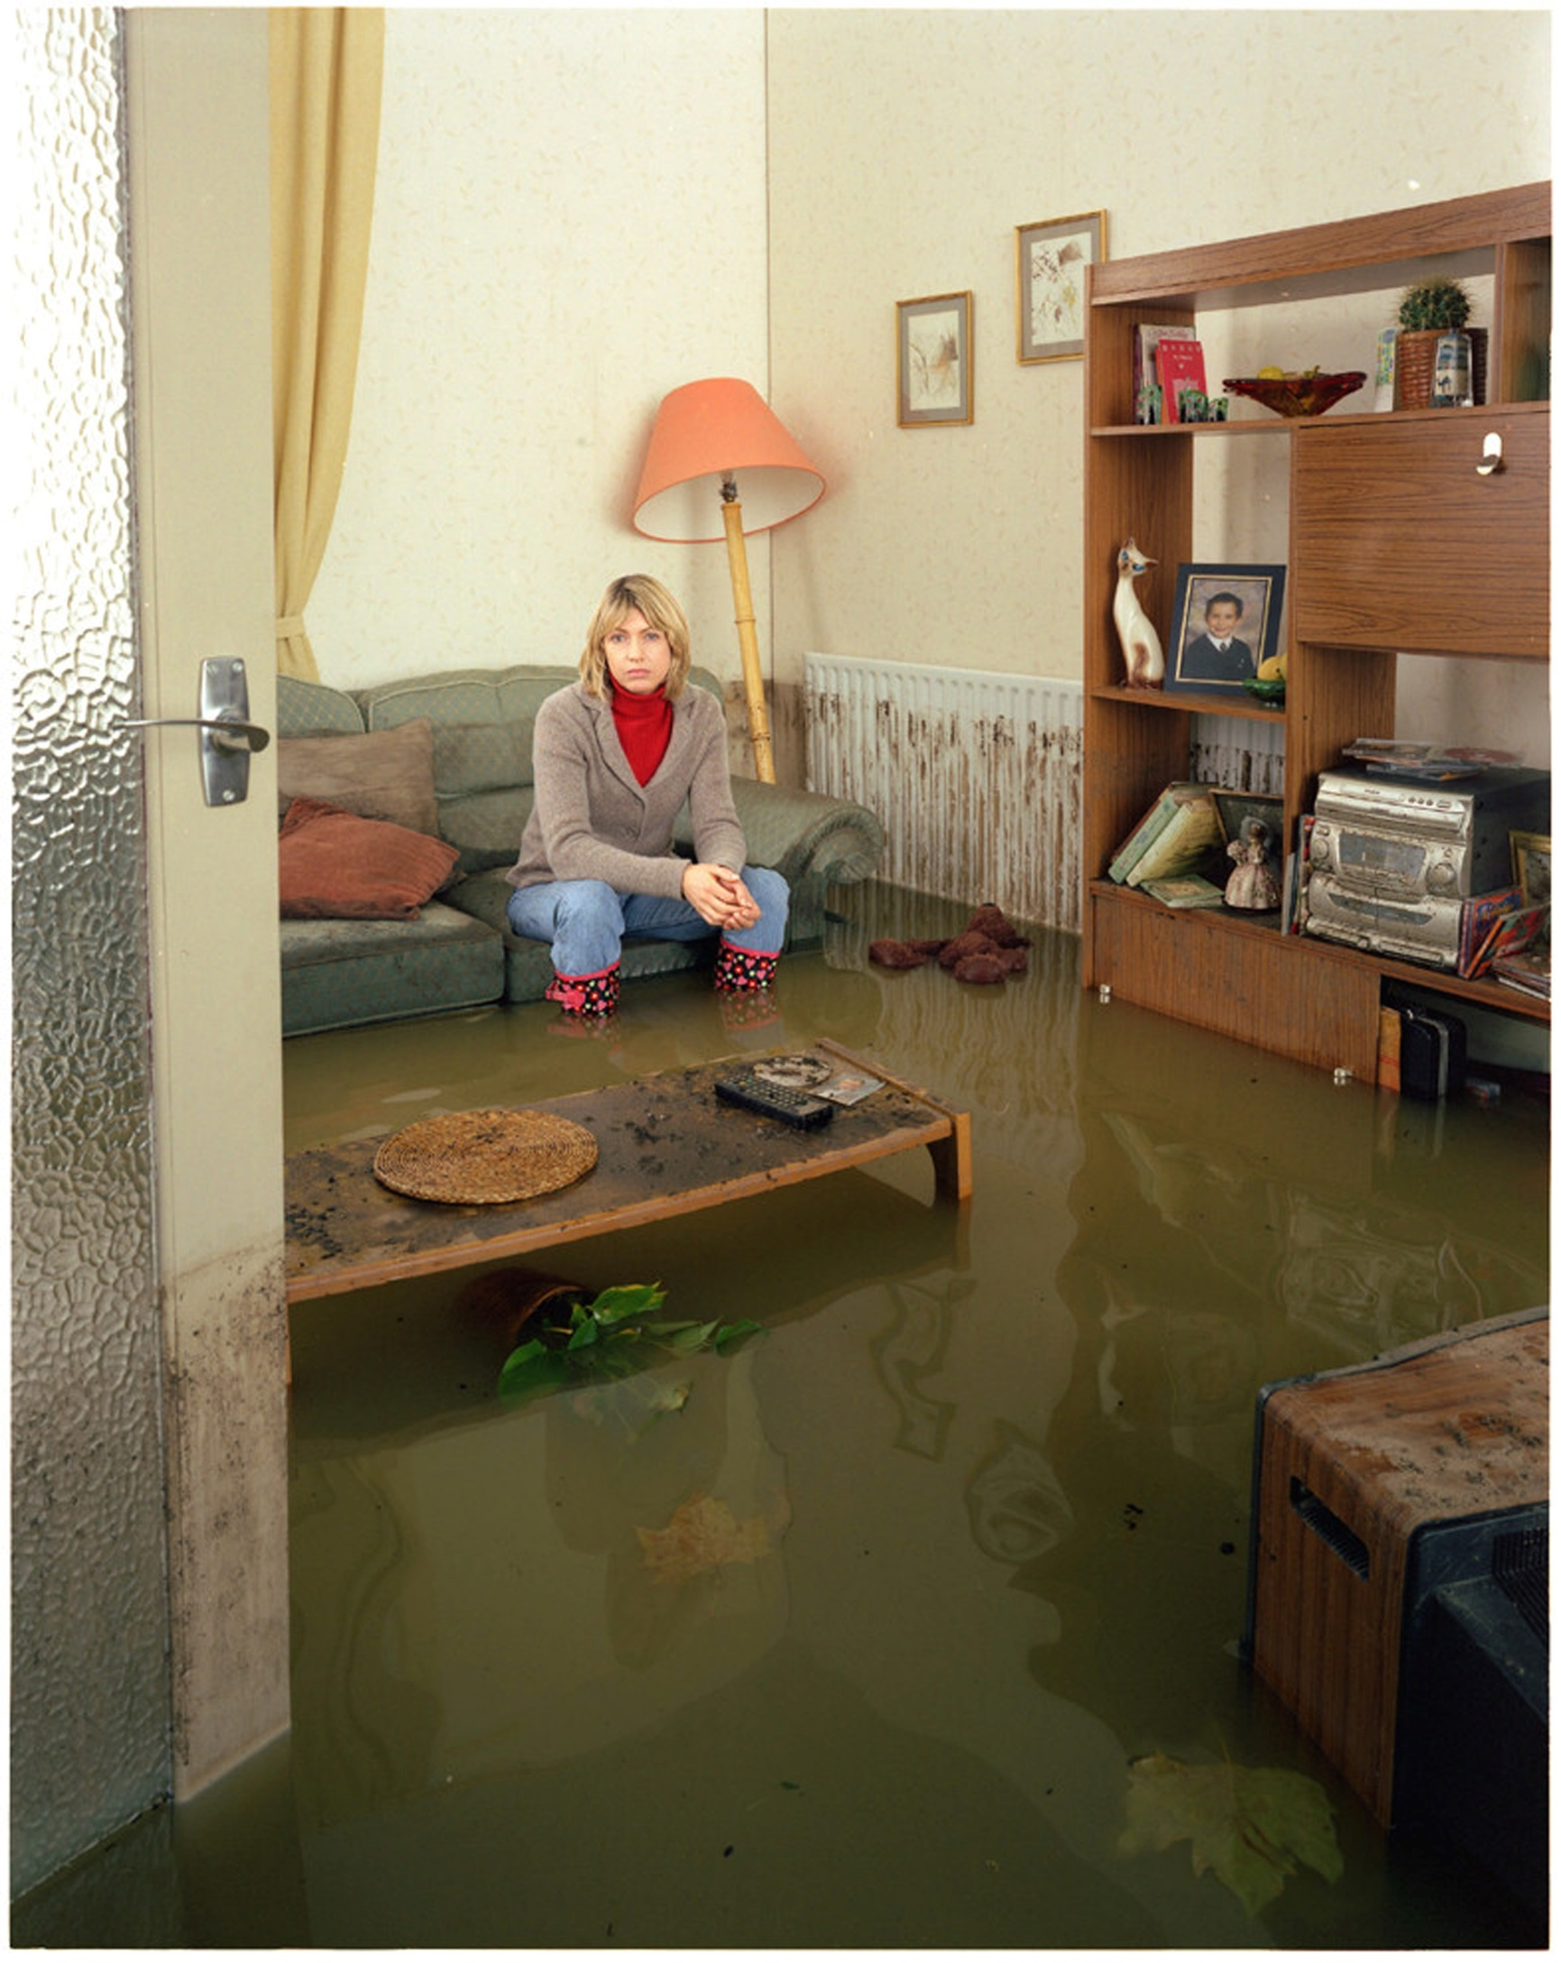
Being prepared
Protects you and your family
Reduces damage to your home and personal belongings saving you money
Means you can return back to your home sooner after flooding
Reduces likelihood of suffering mental health impacts
Find out how to prepare at National Flood Forum or visit Prepare for Flooding page on Gov.uk

Slide 16

Property flood protection
In order to prepare for flooding and become more resilient to its effects, you can implement property flood protection measures in your home.
These measures include both flood resistance (keeping water out) and flood resilience (reducing damage when water enters).
There are many different products and techniques available to help protect your property. For more detailed information visit the Flood Hub online.

Slide 17

The Blue Pages

Slide 18
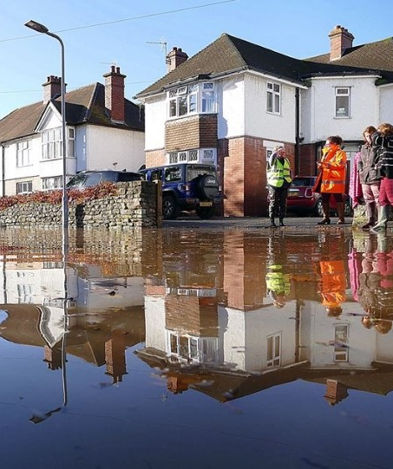
Further information
Visit What to do in a Flood on Gov.uk
Call Floodline on 0345 988 11 88
Email enquiries@environment-agency.gov.uk

Slide 19
Further support
We can give you advice and help to prepare
Local authorities setup rest centres and can help with recovery
For mental health support see www.mind.org.uk British Red Cross or Samaritans
FloodRe www.floodre.co.uk for support with insurance
Stay safe and well after a flood:
Public Health England www.gov.uk/flooding-health-guidance-and-advice
National flood forum or 01299 403 055

Slide 20
Any Questions?
Thanks for listening

